Slide 1
Durable Azure Functions

Slide 2
Azure Functions Basics
Serverless, on-demand, triggers

Slide 3
Serverless
Abstraction of servers – no distractions around server management
Developers focus on code!
Instant, on-demand resources
Event-driven strategy
Autoscale based on workload
Technologies supported:
  Azure Functions
  Azure Logic Apps
  Azure App Service WebJobs
  Microsoft Flow

Slide 4
FaaS
Single responsibility – small, reusable pieces of code
Short lived
Stateless
Event driven & scalable

Slide 5
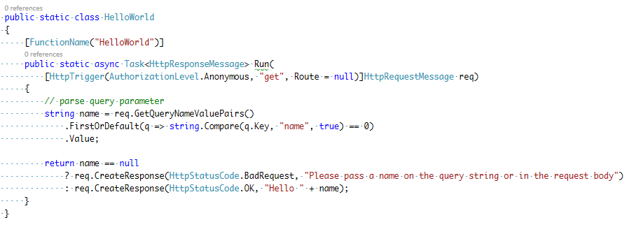
Example
HTTP GET: http://your-api-url.com/api/HelloWorld

Slide 6
Triggers and integrations
HTTP – RESTful APIs
Timers
Azure Service Bus – queues and topics
Azure Storage – queues and blobs
CosmosDB
Azure Event Grid
Azure Event Hub
Twilio (SMS Messages)
Cognitive Services

Slide 7
Billing
Consumption plan
  Azure provides infrastructure by automatically allocating computing resources
  Autoscale up or down
  Paying for time the code is running
  async/await !
App Service plan
  Hosted on dedicated VMs
  Basic, Standard, Premium, Isolated SKUs
Storage is separate cost – used for managing functions

Slide 8
FaaS
Single responsibility – small, reusable pieces of code
Short lived
Stateless
Event driven & scalable
What if my problem isn’t simple, short lived and stateless?

Slide 9
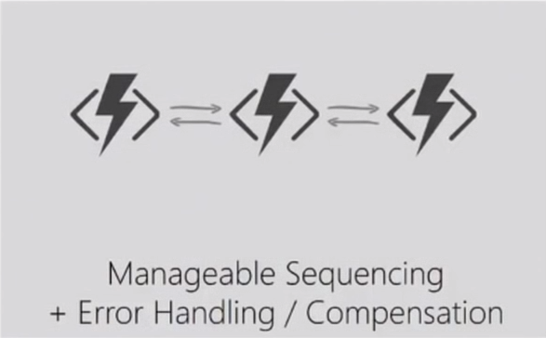
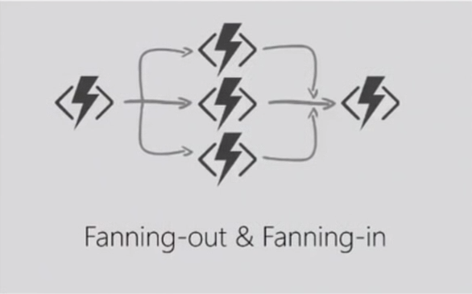
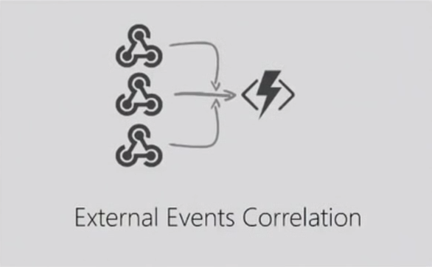
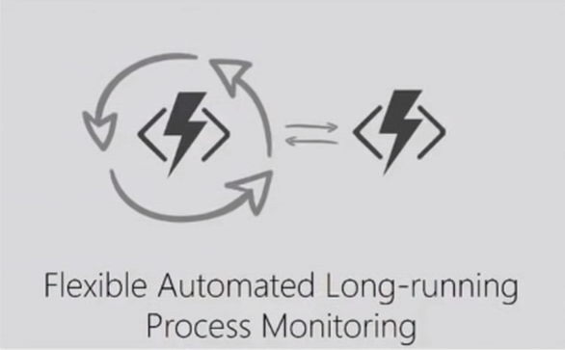
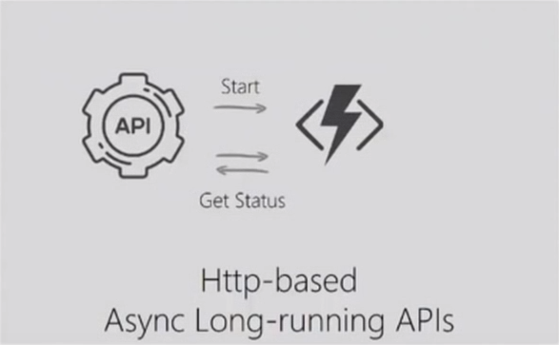
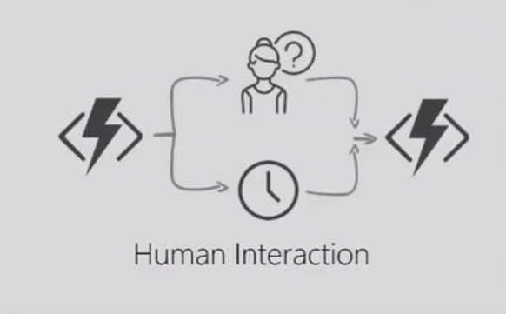
Problems

Slide 10
Durable Azure Functions
Or how to make stateless functions stateful

Slide 11
Durable Functions
Write workflows as a single function with a local state
Code - no JSONs, designers…
Platform manages state, checkpoints and retries for you
Why “stateful”?
  Local state saved by creating a checkpoint on every await
  Call other functions and save output
Microsoft.Azure.WebJobs.Extensions.DurableTask

Slide 12
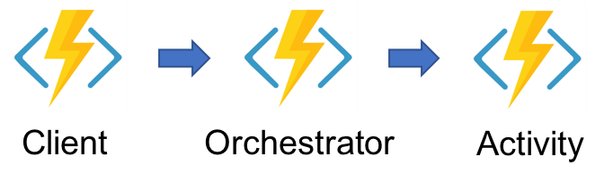
Durable Function Types – Demo
Client – initiates an orchestrator
Orchestrator – describes which actions are executed
Activity – executes code, unit of work

Slide 13
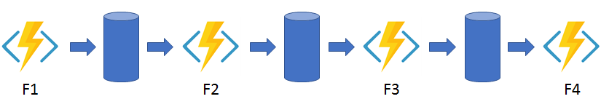
Pattern #1 – Function Chaining

Slide 14
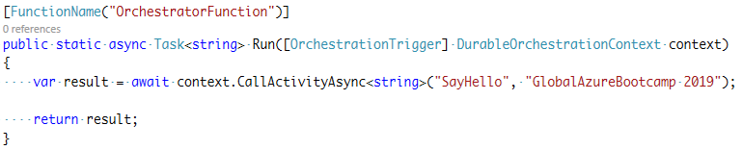

Behind the scenes – how it all works
History table
Orchestrator
Activity
Orchestrator started
Execution started
Task Scheduled, SayHello, “GAB 2019”
Orchestrator completed
X
Task Completed, SayHello, “GAB 2019”
“Hello GAB 2019"
“Hello GAB 2019"
“Hello GAB 2019"
Orchestrator started
?
Execution completed, “Hello GAB 2019”
Orchestrator completed
Execution history

Slide 15
Replay
If activity is already executed, during replay it’s output is retrieved. Activities are not re-executed.
Orchestrator code is/must be deterministic
Activity code can be non-deterministic

Slide 16
Orchestrator code constraints
No generation of random numbers, GUIDs, retrieval of dates with DateTime
  Alternatives: context.NewGuid, context.GetCurrentUtcDateTime
Never initiate any async operation, except by using DurableOrchestrationContext
No thread blocking (Thread.Sleep, Delay etc.)
  Alternative: DurableOrchestrationContext.CreateTimer

Slide 17
Durable Functions Features
Sub-orchestrations
Durable timers (maximum is 7 days!)
External events
Custom retry policies
Bridge communication across function apps

Slide 18
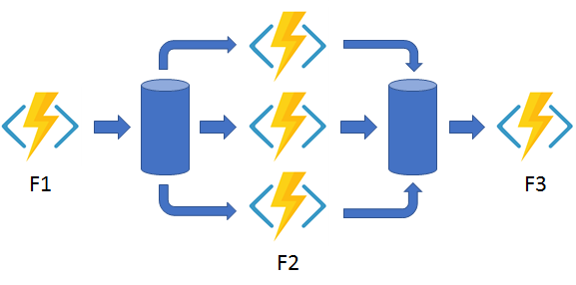
Pattern #2 – Fan out/fan in

Slide 19
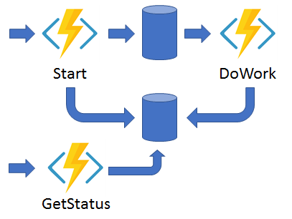
Pattern #3 – Async HTTP APIs

Slide 20
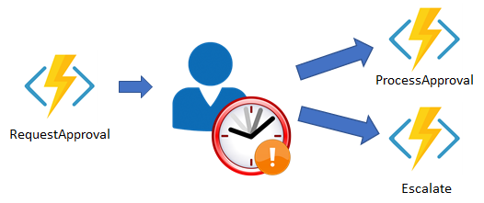
Pattern #4 – Human interaction

Slide 21
If you want to learn more…
Demo examples
  https://github.com/mirzavucijak/durableazurefunctionsdemo
“Serverless Architecture” by Martin Fowler
  https://martinfowler.com/articles/serverless.html
Azure Functions Documentation
  https://docs.microsoft.com/en-us/azure/azure-functions/
Durable Azure Functions Documentation
  https://docs.microsoft.com/en-us/azure/azure-functions/durable
GitHub repositories
  https://github.com/Azure/Azure-Functions
  https://github.com/Azure/azure-functions-durable-extension

Slide 22
Q&A

